Slide 1
Computer Communication 18CSS202J
WEEK 4 SESSION 2
By,
A.JOTHIMANI

Slide 2
LINK STATE ROUTING
Link state routing has a different philosophy from that of distance vector routing.
In link state routing, if each node in the domain has the entire topology of the domain—the list of nodes and links, how they are connected including the
Type
Cost (metric)
The condition of the links (up or down)—the node can use the Dijkstra algorithm to build a routing table.
This method uses the term link-state to define the characteristic of a link (an edge) that represents a network in the internet.
Links with lower costs are preferred to links with higher costs.
If the cost of a link is infinity, it means that the link does not exist or has been broken.

Slide 3
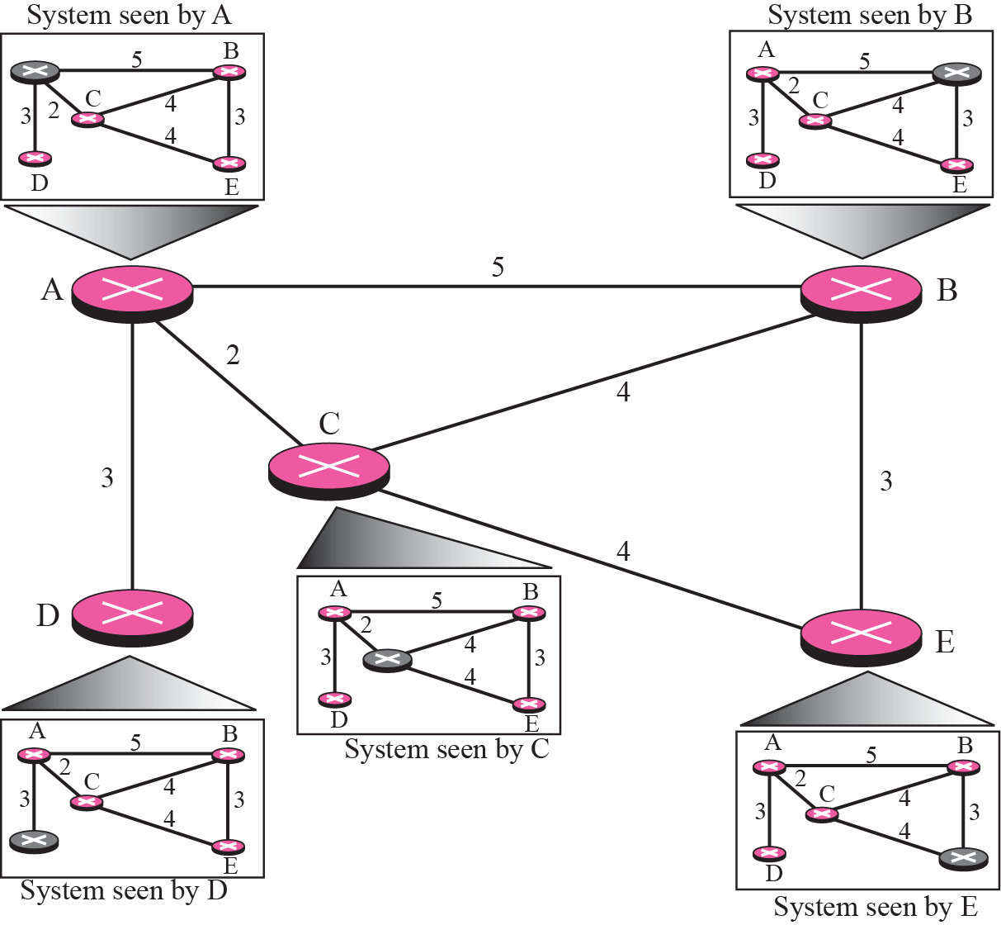
Concept of Link state routing

Slide 4
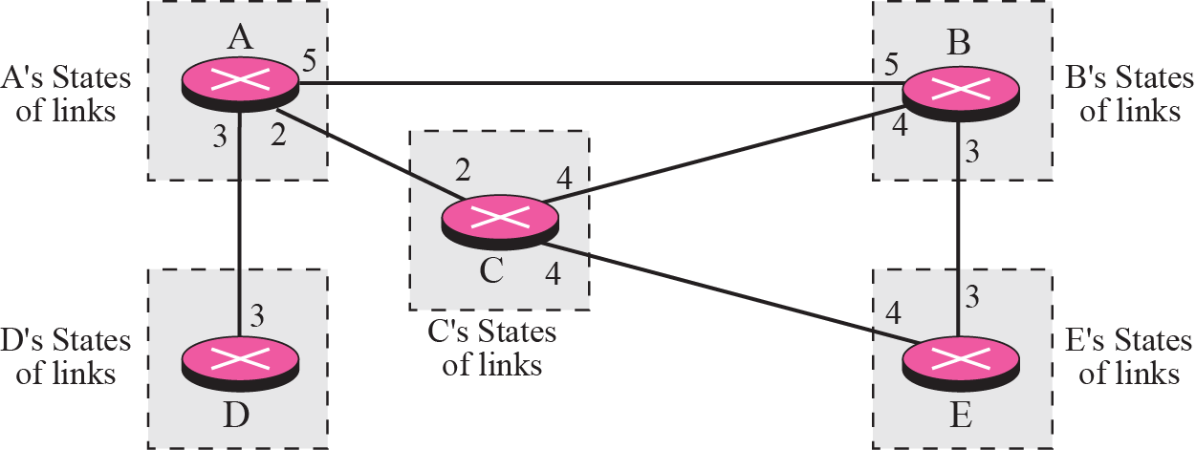
Link state knowledge

Slide 5
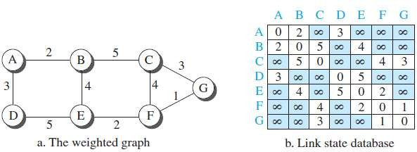
LINK-STATE DATABASE
To create a least-cost tree with this method, each node needs to have a complete map of the network, which means it needs to know the state of each link.
There is only one LSDB for the whole internet.

Slide 6
CONTD..
how each node can create this LSDB that contains information about the whole internet?
This can be done by a process called flooding.
Each node can send some greeting messages to all its immediate neighbors to collect two pieces of information for each neighboring node:
The identity of the node.
The cost of the link.
The combination of these two pieces of information is called the LS packet (LSP).
The LSP is sent out of each interface, as shown in following Figure.

Slide 7
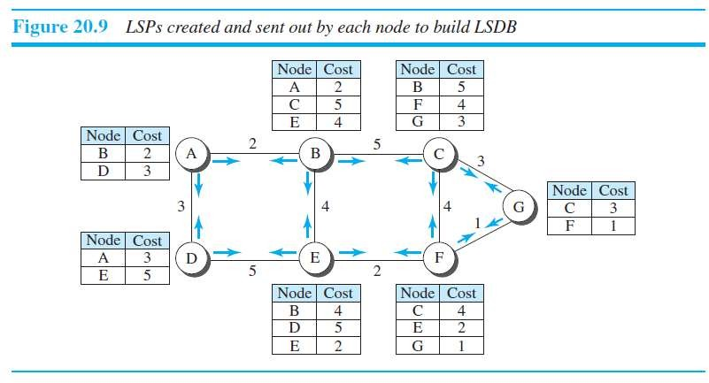

Slide 8
CONTD..
When a node receives an LSP from one of its interfaces, it compares the LSP with the copy it may already have.
If the arrived LSP is older than the one it has, it discards
the arrived LSP.
If it is newer than the one it has, the node discards the old LSP and keeps the received one.
It then sends a copy of it out of each interface except the
one from which the packet arrived.

Slide 9
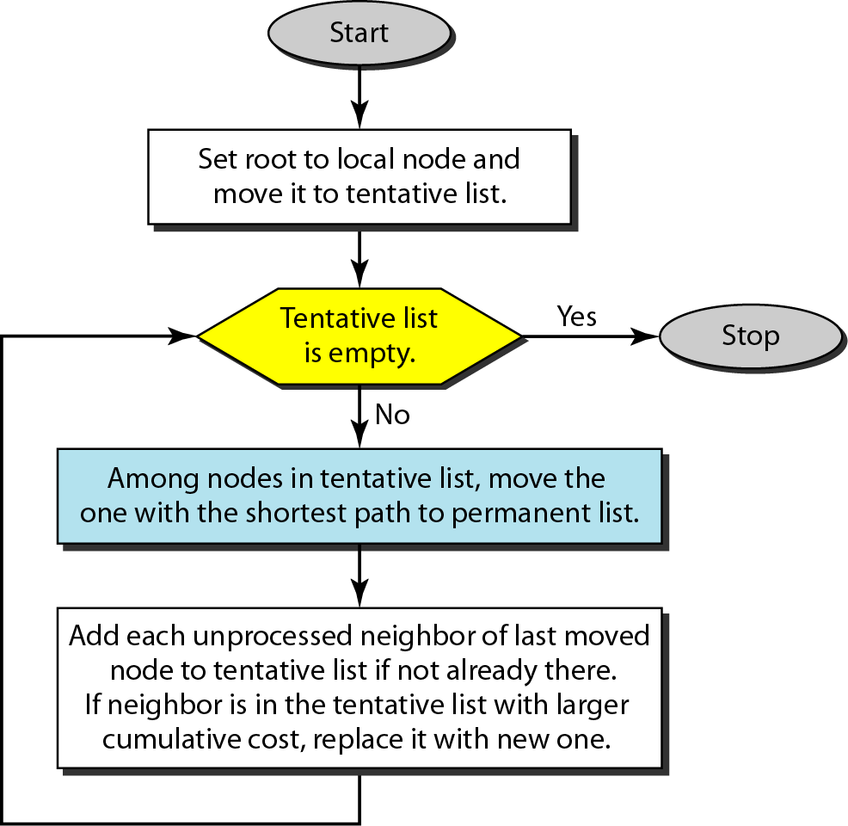
FORMATION OF LEAST-COST TREES
To create a least-cost tree for itself, using the shared LSDB,
each node needs to run the famous Dijkstra Algorithm.

Slide 10
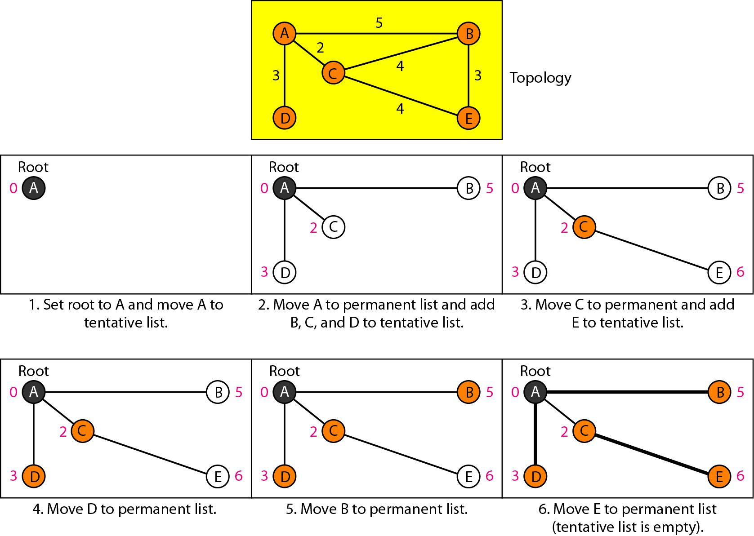
Example of formation of shortest path tree

Slide 11
Routing table for node A

Slide 12
PATH VECTOR ROUTING
Distance vector and link state routing are both interior routing protocols. They can be used inside an autonomous system.
Both of these routing protocols become intractable when the domain of operation becomes large.
Distance vector routing is subject to instability if there is more than a few hops in the domain of operation.
Link state routing needs a huge amount of resources to calculate routing tables. It also creates heavy traffic because of flooding.
There is a need for a third routing protocol which we call path vector routing.
The best route is determined by the source using the policy it imposes on the route.
In other words, the source can control the path.
path-vector routing is not actually used in an internet, and is mostly designed to route a packet between ISPs

Slide 13
The principle of path vector routing is similar to that of distance vector routing.
In path vector, we assume that there is one node in each AS that acts on behalf of the entire AS. This is called as speaker node.
The speaker node in an AS creates a routing table and advertises it to speaker nodes in the neighboring ASs.
A speaker node advertises the path, not the metric of the nodes, in its AS or other ASs.
The idea is the same as for DV routing except that only speaker nodes in each AS can communicate with each other

Slide 14
Initialization
Each speaker node can know only the reachability of nodes inside its AS.
Node A1 is the speaker node for AS1, B1 for AS2, C1 for AS3 and D1 for AS4.
Node A1 creates an initial table that shows A1 to A5 are located in AS1 and can be reached through it.
Node B1 advertises that B1 to B4 are located in AS2 and can be reached through B1. And so on.
Sharing
A speaker in an AS shares its table with immediate neighbors.
Node A1 shares its table with B1 and C1.
Node C1 shares its table with B1 and D1.
Node B1 shares its table with A1 and C1.
Node D1 shares its table with C1.

Slide 15
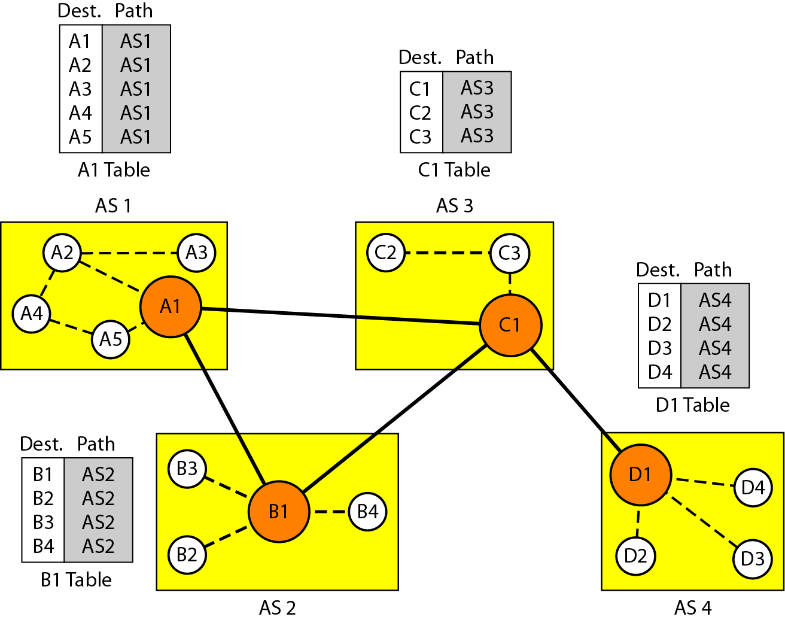
Initial routing tables in path vector routing

Slide 16
Updating
When a speaker node receives a two column table from a neighbor, it updates its own table by adding the nodes that are not in its routing table and adding its own AS and the AS that sent the table.
After a while each speaker has a table and knows how to reach node in other Ass.
Loop prevention
The instability of DV routing and the creation of loops can be avoided in PV routing.
When a router receives a message, it checks to see if its AS is in the path list to the destination.
If it is, looping is involved and the message is ignored.

Slide 17
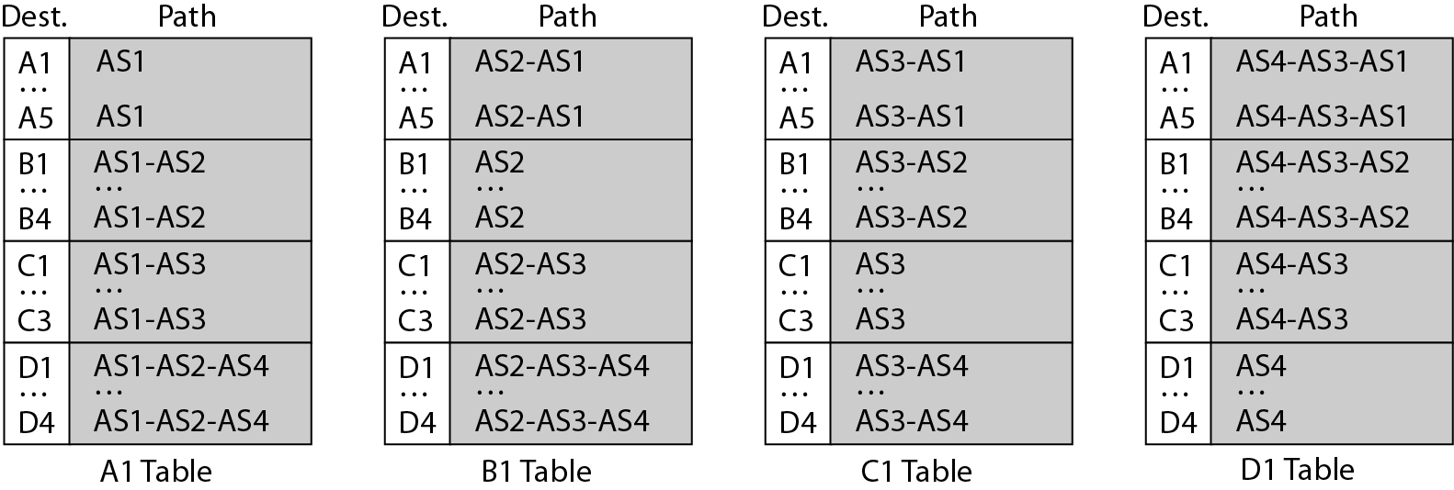
Stabilized tables for three autonomous systems

Slide 18
Policy routing
When a router receives a message, it can check the path.
If one of the AS listed in the path is against its policy, it can ignore that path and that destination.
It does not update its routing table with this path, and it does not send this message to its neighbors.
3. Optimum path
It cannot include metrics in this route because each AS that is included in the path may use a different criterion for the metric.
One system may use, RIP which defines hop count as the metric. Another may use OSPF with minimum delay defined as the metric.
The optimum path is the path that fits the organization.(Eg: AS4 to AS1)
Other criteria, such as security, safety and reliability can also be applied.

Slide 19
SPANNING TREE
The tree determined by the source when it imposes its own policy.
If there is more than one route to a destination, the source can choose the route that meets its policy best.
A source may apply several policies at the same time.
One of the common policies uses the minimum number of nodes to be visited.
common policy is to avoid some nodes as the middle node in a route.
The policy imposed by all sources is to use the minimum number of nodes to reach a destination.
The spanning tree selected by A and E is such that the communication does not pass through D as a middle node.

Slide 20
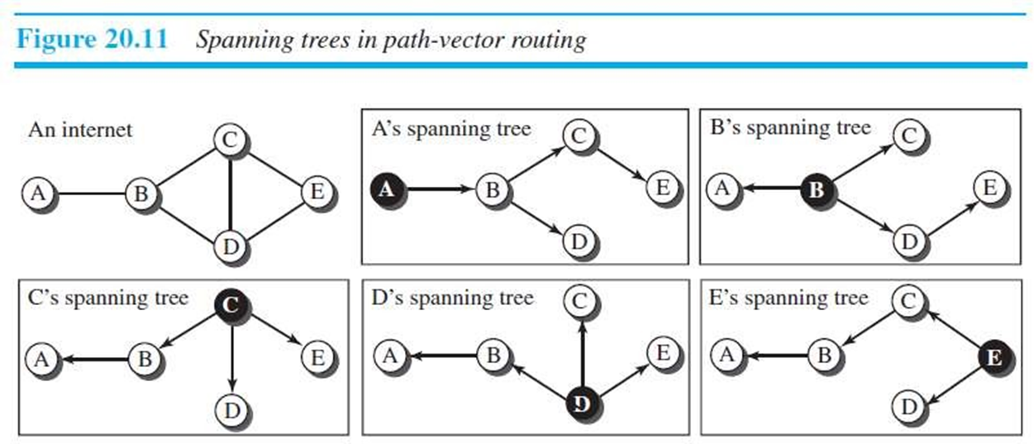

Slide 21
CREATION OF SPANNING TREE
The policy is defined by selecting the best of multiple paths.
Path-vector routing also imposes one more condition on this equation: If Path (v, y) includes x, that path is discarded to avoid a loop in the path.
In other words, x does not want to visit itself when it
selects a path to y.
Path(x,y)=best{Path(x,y),[(x+Path(v,y)]} for all v’s in the internet

Slide 22
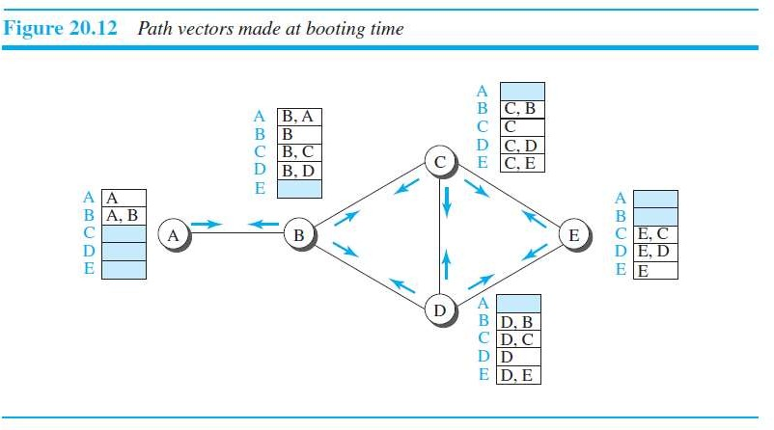
When a node is booted, it creates a path vector based on the information it can obtain about its immediate neighbor.
A node sends greeting messages to its immediate
neighbors to collect these pieces of information.

Slide 23
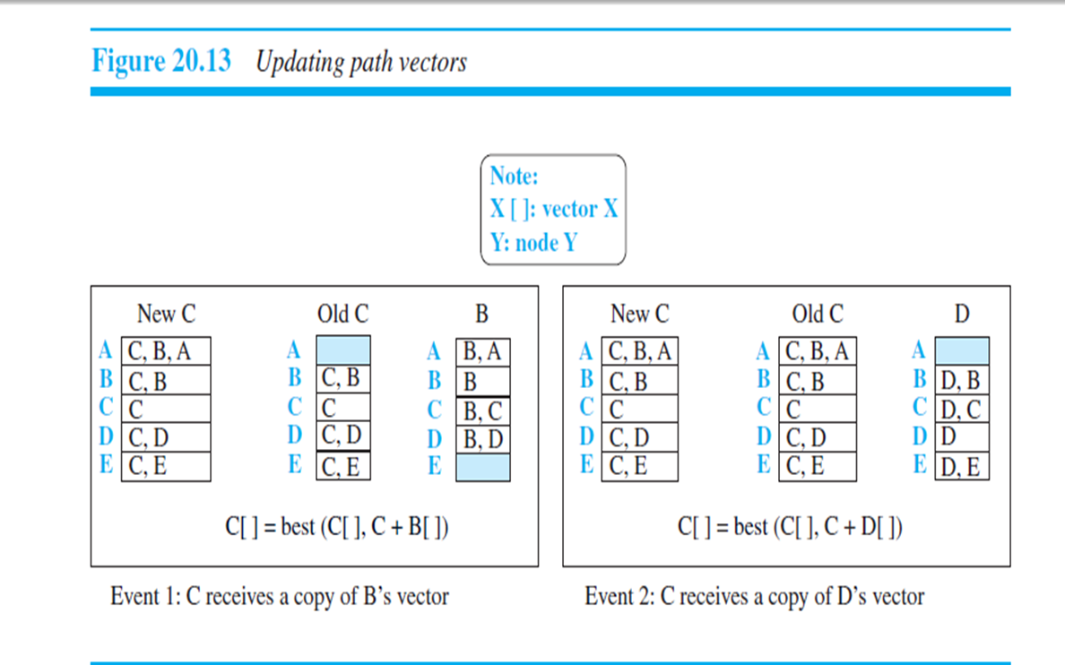
UPDATING PATH-VECTORS

